Slide 1


arrays
BME 121. FALL 2016

Slide 2
Outline:
Quick review 1D array
Definition
Initialization
Assign value
Access elements
2D Arrays
Definition
Initialization
Assign Value
Access elements
Examples
Printing contents of a 2D array.
Reinforce arrays, for loops, and while loops.

Slide 3
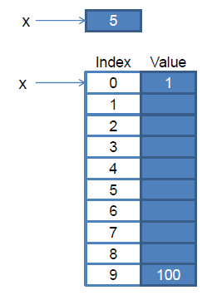



1D array
Arrays
Collection of variables
organized
Same types
Allocate memory for array (make array)
Assign a value to an element of array
Index start from zero
Integer
Symbol for definition of an array
Array
Index
Value
last index = length-1

Slide 4
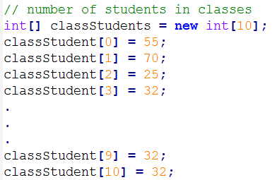
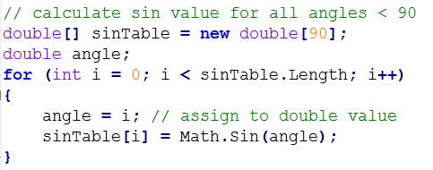
1D array initialization
Initialize all elements

Slide 5


1D array: different initializations
Creation
Declaration and creation
Filling in creation
Implicit size and filling
Implicit creation

Slide 6
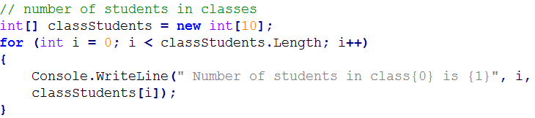
1D array: access the elements
Index start from 0
Last index Length-1

Slide 7

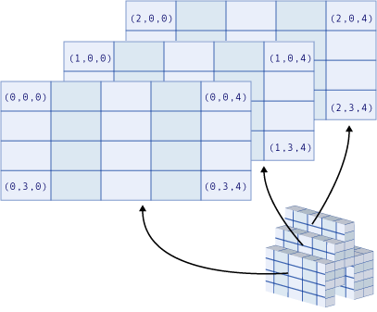
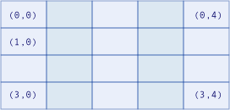
Multi-dimensional rectangular array
1D array
3D array
2D array

Slide 8
2D rectangular array
Definition and creation
Implicit Initialization
int[,] array = new int[4, 2];
First row
Second Row
// Two-dimensional array.
int[,] array2D = new int[,] { { 1, 2 }, { 3, 4 }, { 5, 6 }, { 7, 8 } };
// The same array with dimensions specified.
int[,] array2Da = new int[4, 2] { { 1, 2 }, { 3, 4 }, { 5, 6 }, { 7, 8 } };
// A similar array with string elements.
string[,] array2Db = new string[3, 2] { { "one", "two" }, { "three", "four" },
{ "five", "six" } };
array2D
2 | 1
4 | 3
6 | 5
8 | 7

Slide 9
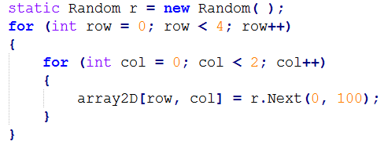
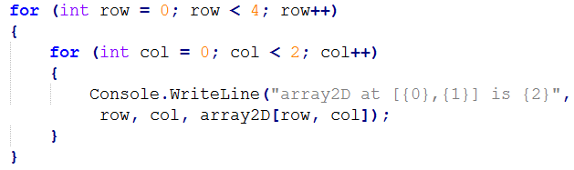
2D rectangular array
Initialization with for loop
Accessing elements

Slide 10
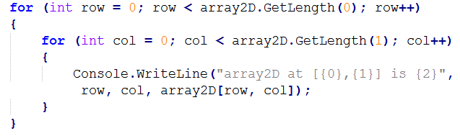
2D rectangular array
Accessing elements
GetLength(int dimension) get the length in the specified dimension

Slide 11
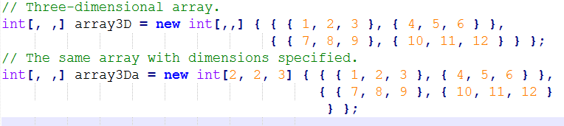
Multi-dimensional arrays
Plane 1
row 2
row 1

Slide 12
Exercise
Write a program, that plots a histogram for a quiz given to a class of students.
The quiz is graded on a scale from 0 to 5.
Use an array to count the number of 0’s, 1’s, 2’s, 3’s, 4’s, and 5’s.
The program should be able to handle an arbitrary number of student grades.
Tips:
You can make an array of size 5, where each element is initialized to zero.
Whenever a value in [0,1) is entered, increment the value of the array
index 0. Whenever a value in [1,2) is entered, increment the value of the
array at index 1… and so on, up to index 4 of the array.
Taken from: Savitch, Walter J. Absolute C++. Pearson Education, 2006.

Slide 13
The end

